Slide 1
Ethan Scott
Solo presentation

Slide 2
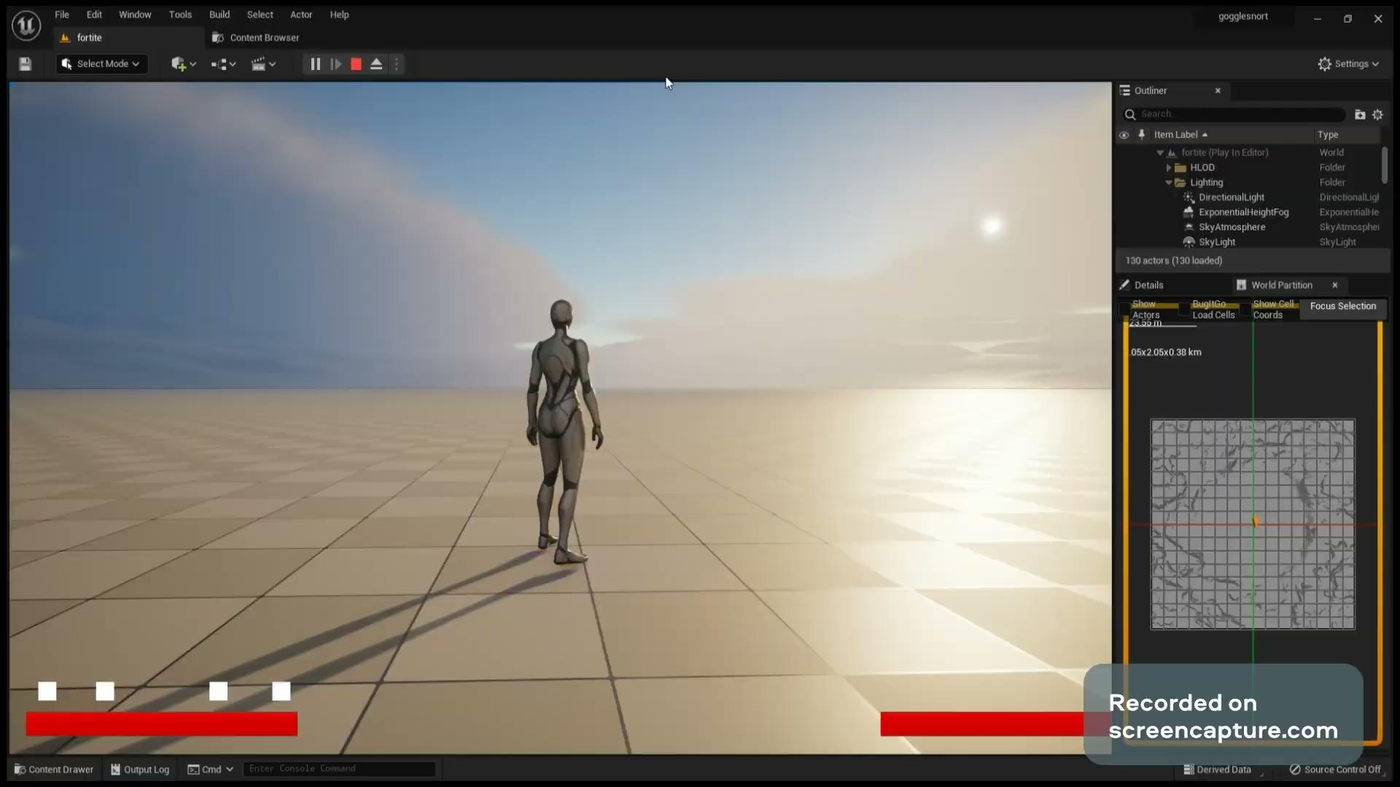
What I’ve worked on this year
I have mainly worked on movement mechanics, mostly the Superjump mechanic, which allows the player to jump at three times the normal jump height and does damage to all surrounding enemies upon landing.

Slide 3
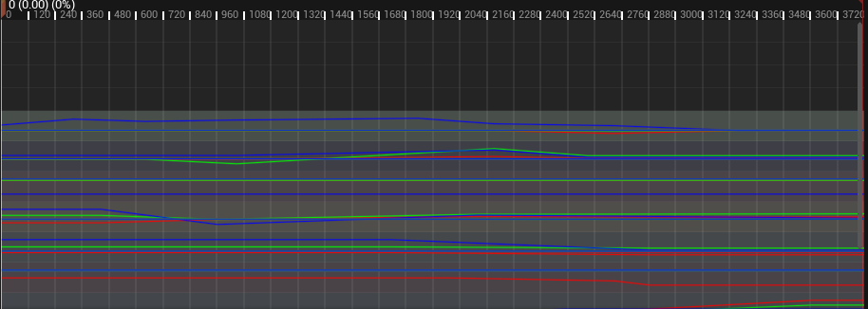
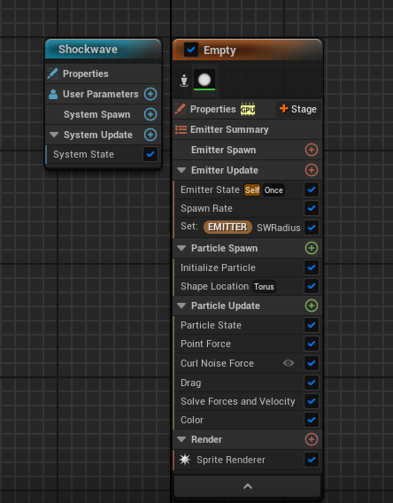
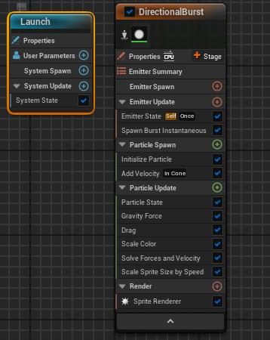
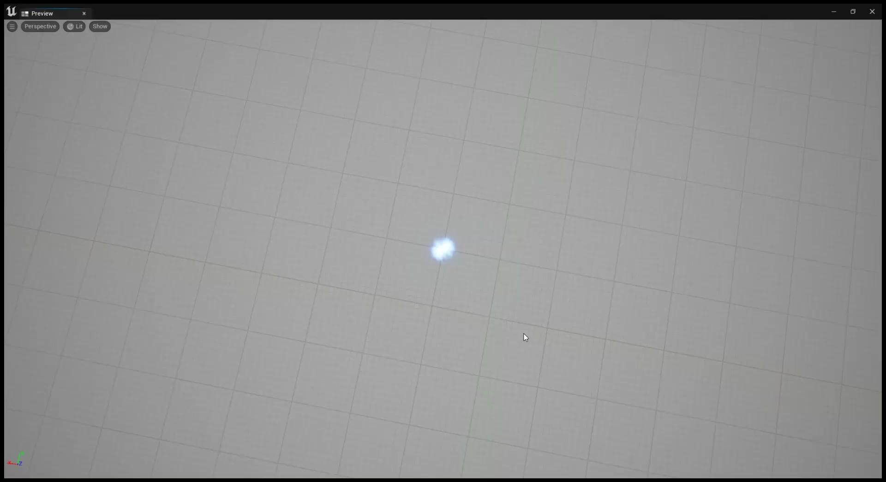
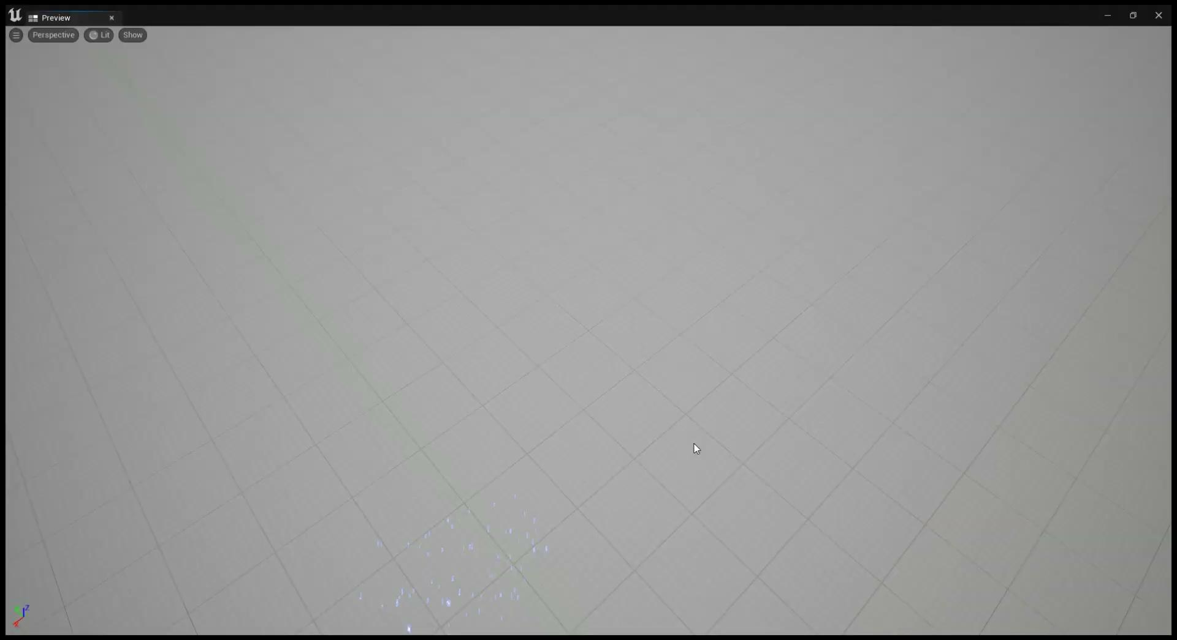
I also made the particle effects for the ability and essentially remade the landing animation.

Slide 4
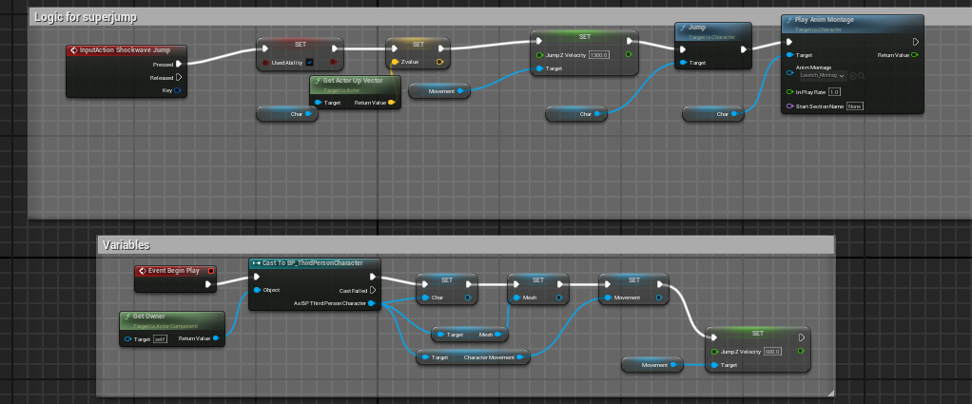
Some code

Slide 5
